Slide 1
Fundamentals of Web Development
JavaScript day 2:
Data type
Version 2.0 Xbi @2024

Slide 2
Go through solutions from last week

Slide 3
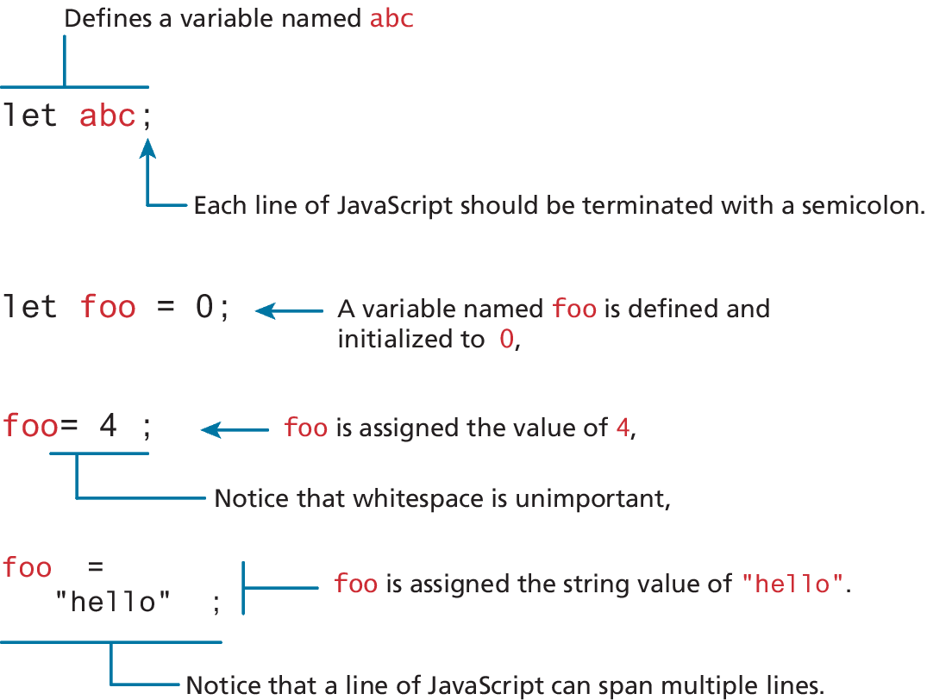
Variables and Data Types
Variables in JavaScript are dynamically typed, meaning that you do not have to declare the type of a variable before you use it.
To declare a variable in JavaScript, use either the var, const, or let keywords (see Table 8.1)
Assignment can happen at declaration time by appending the value to the declaration, or at runtime with a simple right-to-left assignment

Slide 4
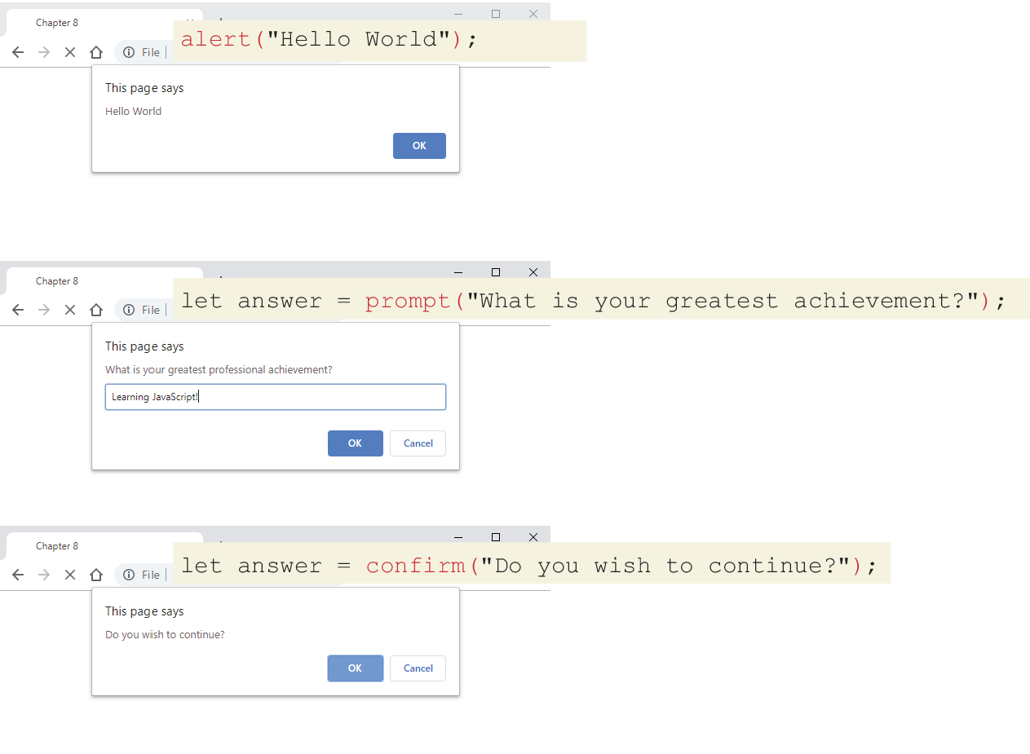
JavaScript Output
alert() Displays content within a browser-controlled pop-up/modal window.
prompt() Displays a message and an input field within a modal window.
confirm() Displays a question in a modal window with ok and cancel buttons.

Slide 5
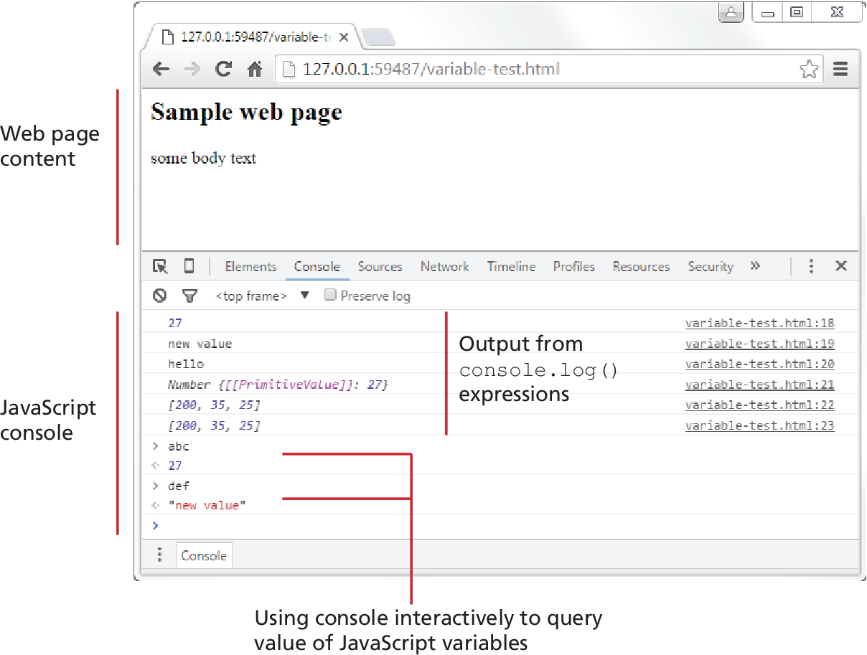
JavaScript Output (ii)
document.write() Outputs the content (as markup) directly to the HTML document.
console.log() Displays content in the browser’s JavaScript console.
Notes:
Demoaleet.html

Slide 6
Data Types-
JavaScript has two basic data types:
reference types (usually referred to as objects)
primitive types (i.e., nonobject, simple types).
What makes things a bit confusing for new JavaScript developers is that the language lets you use primitive types as if they are objects.

Slide 7
Concatenation – string type
To combine string literals together with other variables. Use the concatenate operator (+).
Alternative technique for concatenation is template literals (listing 8.2)
const country = "France";
const city = "Paris";
const population = 67;
const count = 2;
let msg = city + " is the capital of " + country;
msg += " Population of " + country + " is " + population;
let msg2 = population + count;
// what is displayed in the console?
console.log(msg);
//Paris is the capital of France Population of France is 67
console.log(msg2);
// 69
LISTING 8.1 Using the concatenate operator

Slide 8
exercise
JavaScript Reference and Primitive Types
Objective: Research and provide examples of JavaScript reference types (objects) and primitive types (simple types).

Slide 9
Instructions
1. Divide the class into 7 groups of two students each.
2. Research Task: Each group will research JavaScript’s primitive and reference types. They will find an example of each type and be prepared to explain it to the class.
• Primitive Types include: String, Number int, Number float, Boolean,
• Reference Types include: Object**, Array**, Function**, Date**
3. Time Limit: You have 30 minutes to complete the task.
4. Deliverables:
• A short written explanation for each type (primitive and reference) you researched.
• Example code demonstrating how each type works in JavaScript.
5. Presentation: After the 30 minutes, each group will present their findings and code examples to the class.

Slide 10
Conditionals
JavaScript’s syntax for conditional statements is almost identical to that of PHP, Java, or C++.
In this syntax the condition to test is contained within () brackets with the body contained in {} blocks. Optional else if statements can follow, with an else ending the branch.
JavaScript has all of the expected comparator operators (<, >, ==, <=, >=, !=, !==, ===)

Slide 11
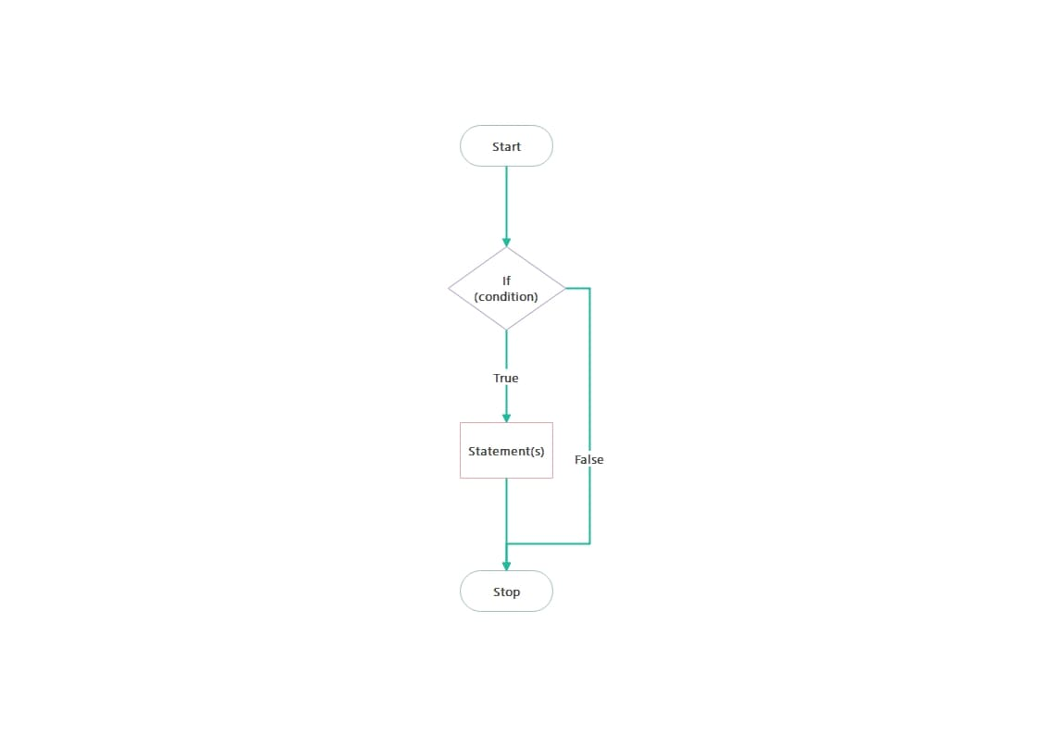
IF Else
https://www.w3schools.com/js/tryit.asp?filename=tryjs_ifthen

Slide 12
Switch statement
The switch statement is similar to a series of if...else statements.
There is another way to make use of conditionals: the conditional operator (also called the ternary operator).
switch (artType) {
case "PT":
output = "Painting";
break;
case "SC":
output = "Sculpture";
break;
default:
output = "Other";
}
// equivalent
if (artType == "PT") {
output = "Painting";
} else if (artType == "SC") {
output = "Sculpture";
} else {
output = "Other";
}
LISTING 8.4 Conditional statement using switch and an equivalent if-else

Slide 13
While and do . . . while Loops
While and do…while loops execute nested statements repeatedly as long as the while expression evaluates to true.
As you can see from this example, while loops normally initialize a loop control variable before the loop, use it in the condition, and modify it within the loop.
let count = 0;
while (count < 10) {
// do something
// ...
count++;
}
count = 0;
do {
// do something
// ...
count++;
} while (count < 10);
LISTING 8.5 While Loops

Slide 14
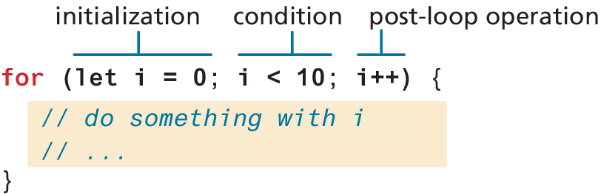
For Loops
For loops combine the common components of a loop—initialization, condition, and postloop operation—into one statement. This statement begins with the for keyword and has the components placed within () brackets, and separated by semicolons (;)

Slide 15
Arrays and for lpps
Arrays are one of the most commonly used data structures in programming.
let numbers = [10, 20, 30, 40, 50];
// Loop through the array and log each number
for (let i = 0; i < numbers.length; i++)
{
console.log(numbers[i]);
}

Slide 16
Syntax sugar Iterating an array using for . . . of
ES6 introduced an alternate way to iterate through an array, known as the for...of loop, which looks as follows.
// iterating through an array
for (let yr of years) {
console.log(yr);
}
//functionally equivalent to for (let i = 0; i < years.length; i++) {
let yr = years[i];
console.log(yr);
}

Slide 17
Array Methods
https://www.w3schools.com/js/js_array_methods.asp

Slide 18
Functions
Functions are defined by using the reserved word function and then the function name and (optional) parameters.
Functions do not require a return type, nor do the parameters require type specifications.

Slide 19
Declaring and calling functions
A function to calculate a subtotal as the price of a product multiplied by the quantity might be defined as follows:
function subtotal(price,quantity) {
return price * quantity;
}
The above is formally called a function declaration. Such a declared function can be called or invoked by using the () operator.
let result = subtotal(10,2);

Slide 20
Function expressions
The object nature of functions can be further seen in the next example, which creates a function using a function expression.
// defines a function using an anonymous function expression
const calculateSubtotal = function (price,quantity) {
return price * quantity;
};
// invokes the function
let result = calculateSubtotal(10,2);
// define another function
const warn = function(msg) { alert(msg); };
// now invoke that function
warn("This doesn't return anything");
LISTING 8.11 Sample function expressions

Slide 21
Objects
We have already encountered a few of the built-in objects in JavaScript, namely, arrays along with the Math, Date, and document objects.
In this section, we will learn how to create our own objects and examine some of the unique features of objects within JavaScript.
In JavaScript, objects are a collection of named values (which are called properties in JavaScript).
Unlike languages such as C++ or Java, objects in JavaScript are not created from classes. JavaScript is a prototype based language, in that new objects are created from already existing prototype objects.

Slide 22
Object Creation Using Object Literal Notation
The most common way is to use object literal notation (which we also saw earlier with arrays)
An object is represented by a list of key-value pairs with colons between the key and value, with commas separating key-value pairs.
To reference this object’s properties, we can use either dot notation or square bracket notation.
const objName = {
name1: value1,
name2: value2,
// ...
nameN: valueN
};
objName.name1
objName["name1"]

Slide 23
Workshop del II og exercise

